Slide 1


MATH 500
DATA SCIENCE SEMINAR
The lease
analyzers
UNDERSTANDING SAVILL'S DATASET ABOUT LEASING FROM 2018-2024
Team
Khushi Choudhary
Zakir Elaskar
Pushpak Rane
01

Slide 2
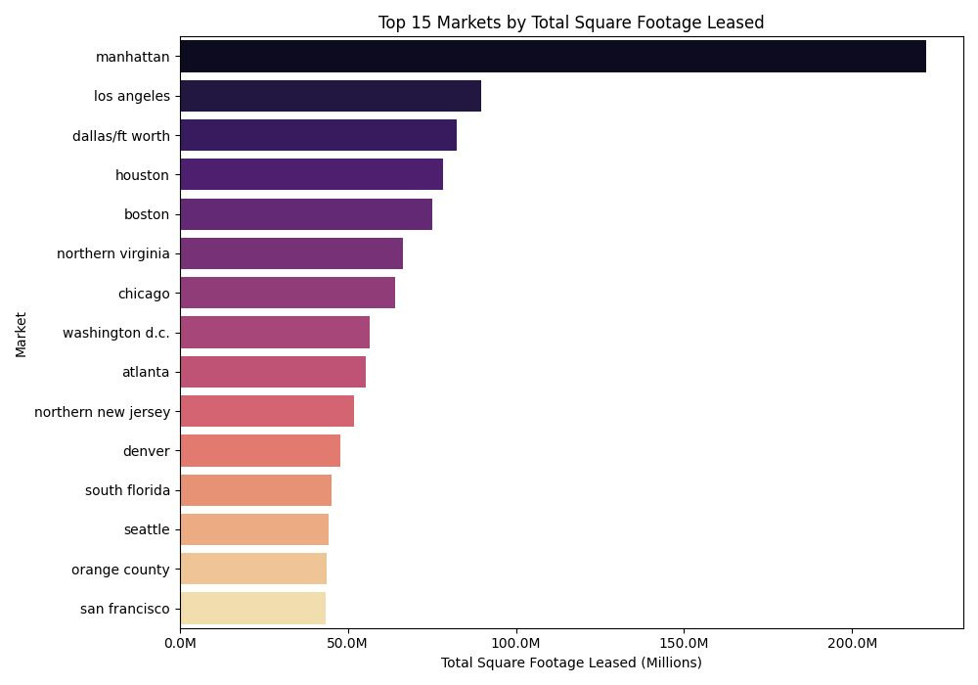
Identifying the Powerhouses: Where is Leasing Concentrated?
ANALYSIS RANKS TOP 15 US MARKETS BY TOTAL SQUARE FOOTAGE LEASED (2018-2024).
HIGHLIGHTS CONCENTRATION: KEY HUBS LIKE MANHATTAN, LA, orange county DOMINATE ACTIVITY.
02

Slide 3
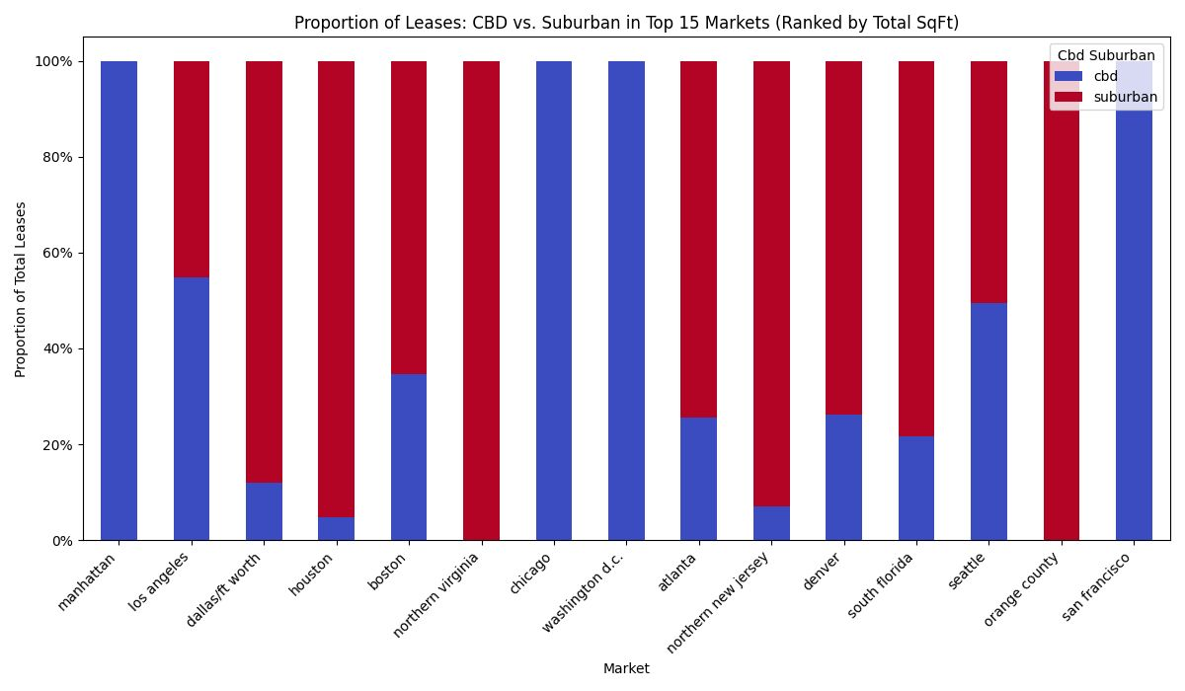
Market Personalities: Downtown Core or Suburban Sprawl?
Compares Central Business District (CBD) vs. Suburban leasing within top markets.
Reveals distinct location strategies: e.g., Manhattan (CBD-heavy) vs. orange county (Suburban-heavy).
02

Slide 4
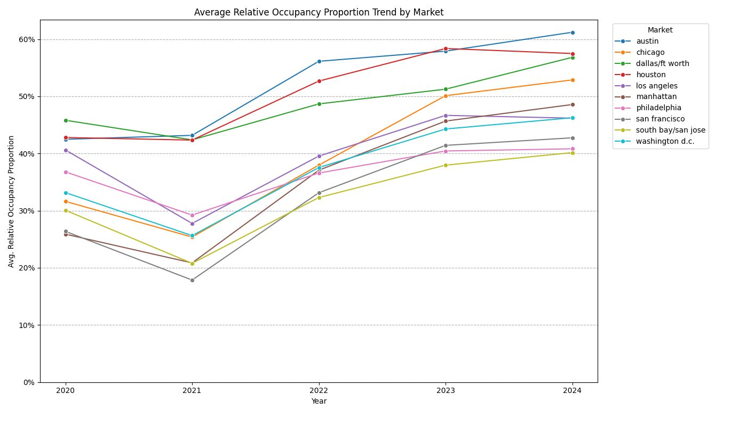
Gauging Market Pulse: Tracking Post-Pandemic Occupancy Recovery.
Shows average occupancy trend (2020-2024) relative to March 2020 baseline for key markets.
Demonstrates varied recovery speeds and trajectories across different cities.
03

Slide 5
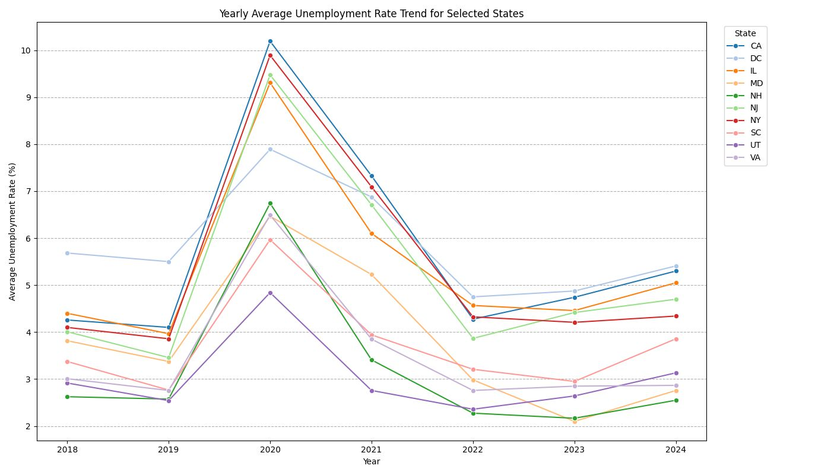
Economic Context: Unemployment's Impact and Recovery Paths.
Tracks average yearly unemployment rates for selected key states (2018-2024).
Illustrates the shared 2020 economic shock and subsequent differing recovery paths.
03

Slide 6

MATH 500
DATA SCIENCE SEMINAR
thank
you!
04
WWW.REALLYGREATSITE.COM

